Slide 1
Think champ private limited
Free Excel Training
Basic to advance Training
Day 2

Slide 2
Topics to be covered
Ranges
Filling
Move Cells
Add Cells

Slide 3
Excel Range
In Excel, knowing about "Range" is important because it helps you choose cells. There are four ways to do this:
Selecting a cell
Selecting multiple cells
Selecting a column
Selecting a row
Before having a look at the different operations for selection, we will introduce the Name Box.

Slide 4
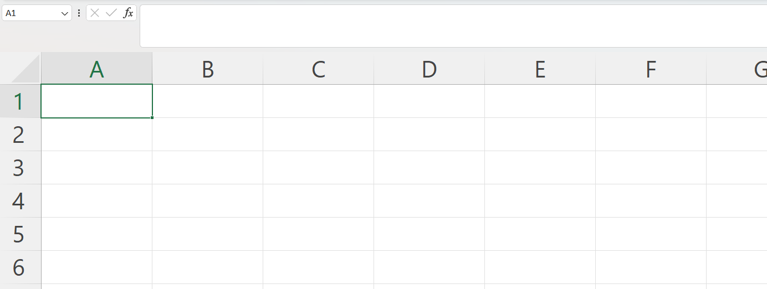
Excel range
The Name Box
The Name Box shows you the reference of which cell or range you have selected. It can also be used to select cells or ranges by typing their values.

Slide 5
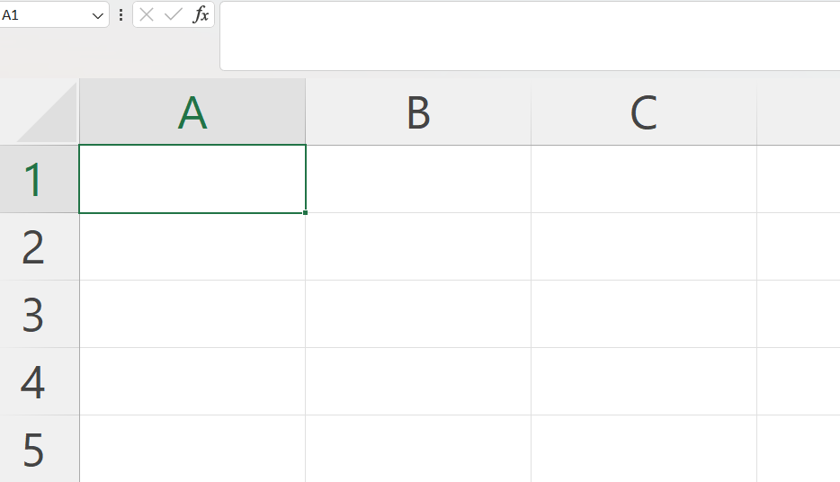
Selecting a Cell
You can choose cells in Excel by clicking on them with the left mouse button or by moving to them using the arrow keys on your keyboard. Using the mouse is the easiest way to pick cells.

Slide 6
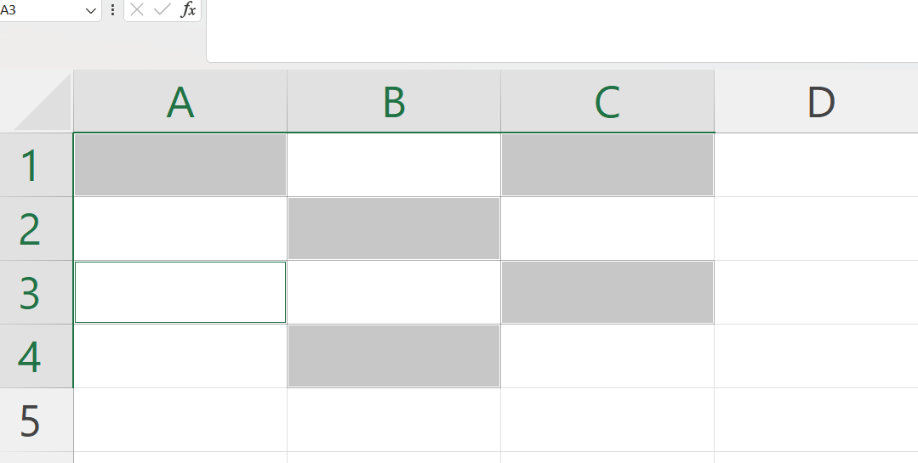
Selecting Multiple Cells
To pick more than one cell in Excel, Hold CTRL (or Command) key, click cells, release CTRL (or Command).

Slide 7
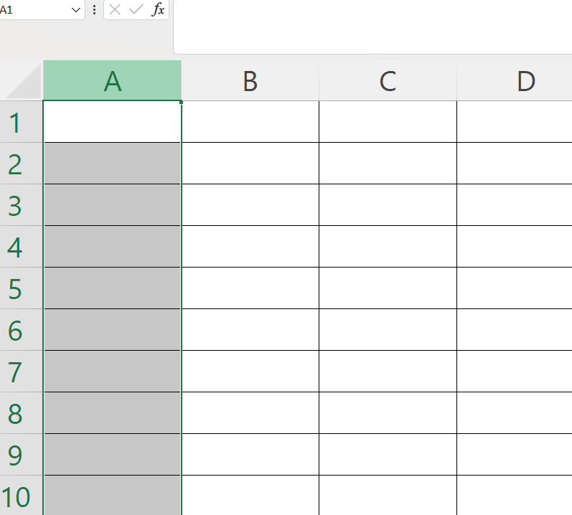
Selecting a Column
To pick a whole column in Excel, just click on the letter at the top of that column. For example, to select all of column A, click on the letter A.

Slide 8
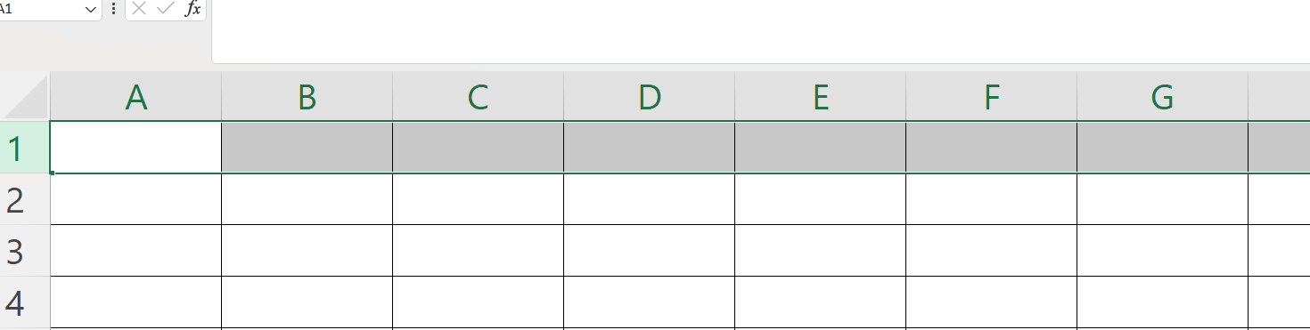
Selecting a Row
To choose an entire row in Excel, click on the number at the left side of that row. For instance, to select all of row 1, click on the number 1.

Slide 9
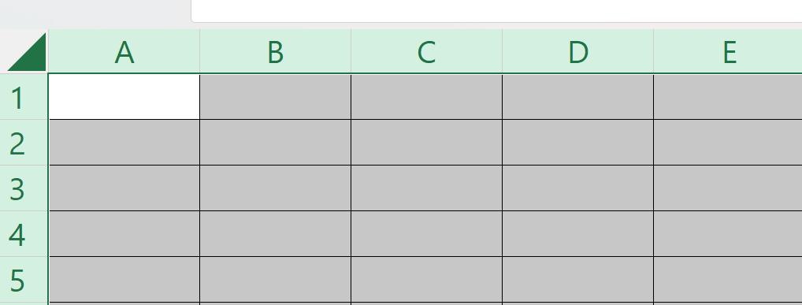
Selecting the Entire Sheet
To pick everything in your Excel sheet, just click on the little triangle at the top-left corner.
You can also select the entire spreadsheet by pressing Ctrl+A for Windows

Slide 10
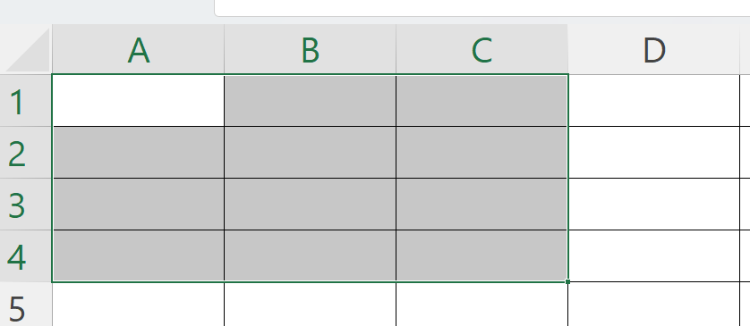
Selection of Ranges
Selecting cell ranges is a crucial skill in Excel, and it has various applications.
Pick a cell.
Click and hold the left mouse button.
Move your mouse over the cells you want. They'll turn grey.
Let go of the mouse button.
A1:C4

Slide 11
Excel Fill
Filling is a handy trick in Excel that saves you from typing everything manually.
Copying
Creating sequences
Adding dates
Fill Copies
Filling can be used for copying. It can be used for both numbers and words.
Click the fill icon and hold down the left mouse button, drag and mark the range that you want to cover.
Filling the range A1:A10 creates ten copies of 1.

Slide 12
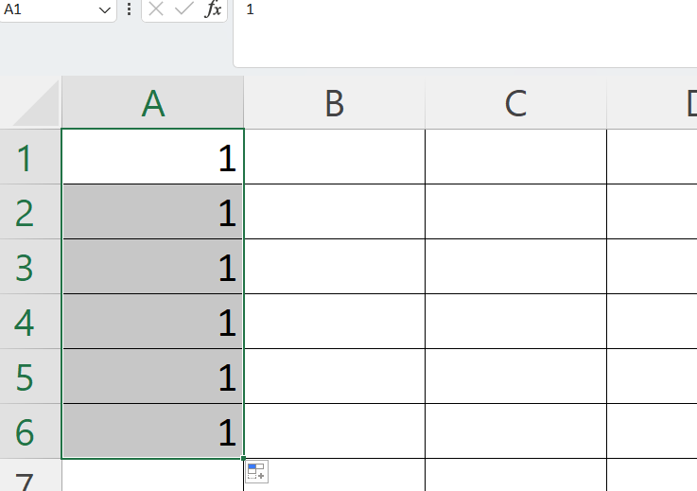
Excel fill:
Fill Copies
Filling can be used for copying. It can be used for both numbers and words.
Click the fill icon and hold down the left mouse button, drag and mark the range that you want to cover.
Filling the range A1:A10 creates ten copies of 1:

Slide 13
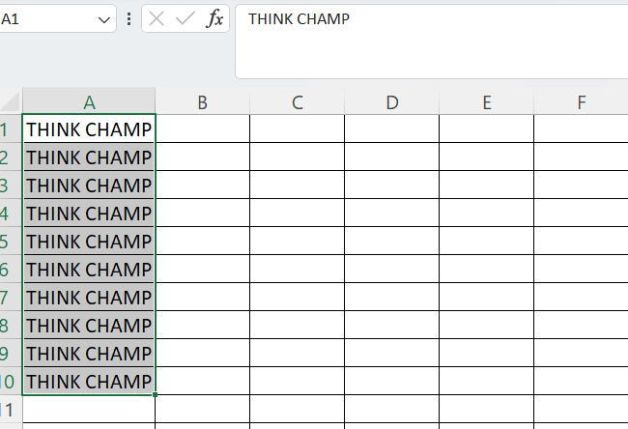
FILL COPIES
Filling the range A1:A10 creates ten copies of “THINK CHAMP":

Slide 14
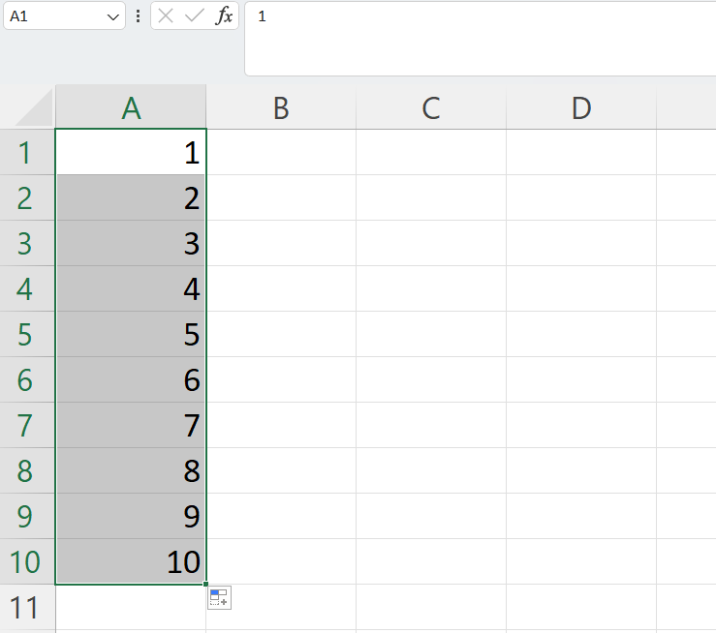
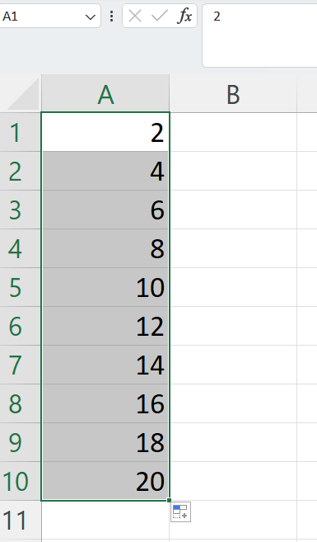
Fill Sequences
Filling in Excel helps you make sequences, which are just ordered patterns. You can use filling to keep a pattern going, like with numbers or dates.

Slide 15
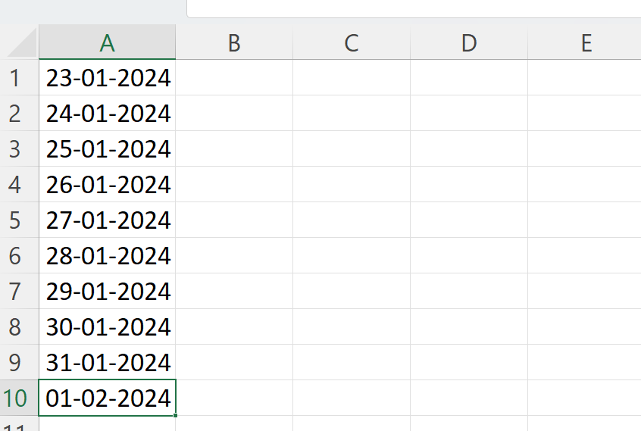
Sequence of Dates
The fill process has filled 10 days from A1(24.01.2024) to A10(01.02.2024).

Slide 16
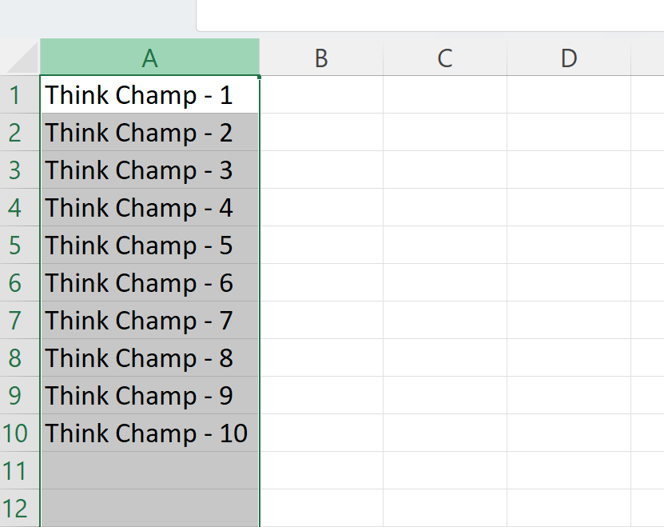
Combining Words and Letters
Words and letters can also be combined.
Type A1(Hello 1) and A2(Hello 2)
Next , fill A1:A10

Slide 17
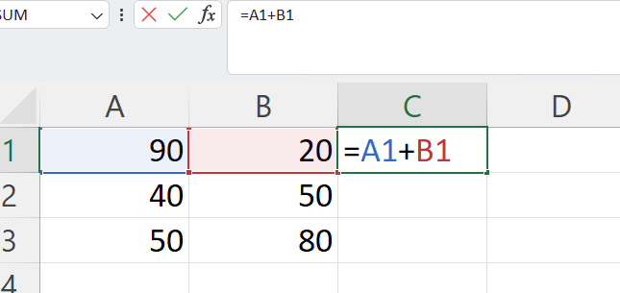
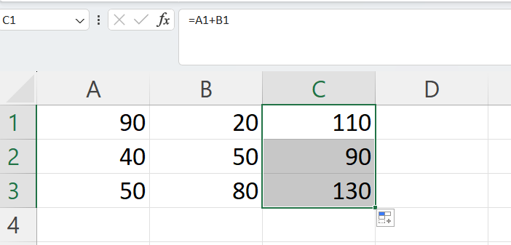
Double Click to Fill
Select C1
Type =
Select A1
Type +
Select B1
Hit enter

Slide 18
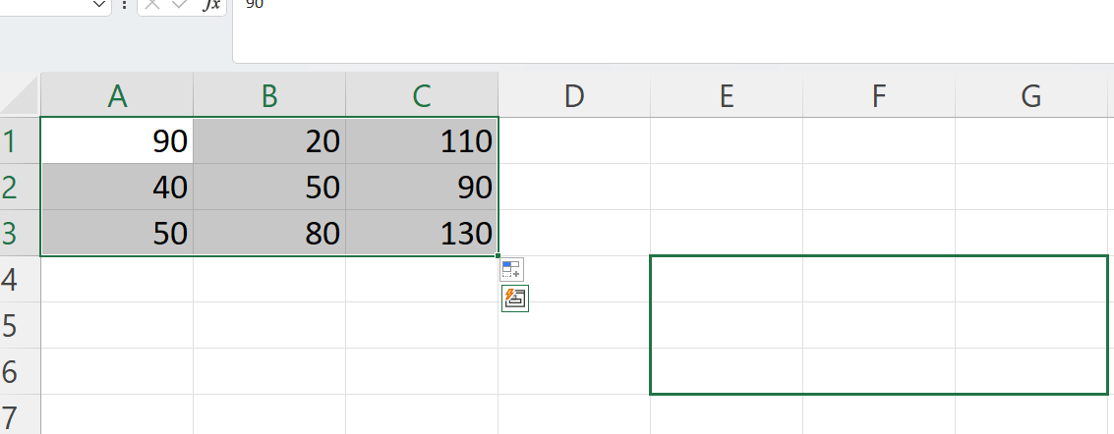
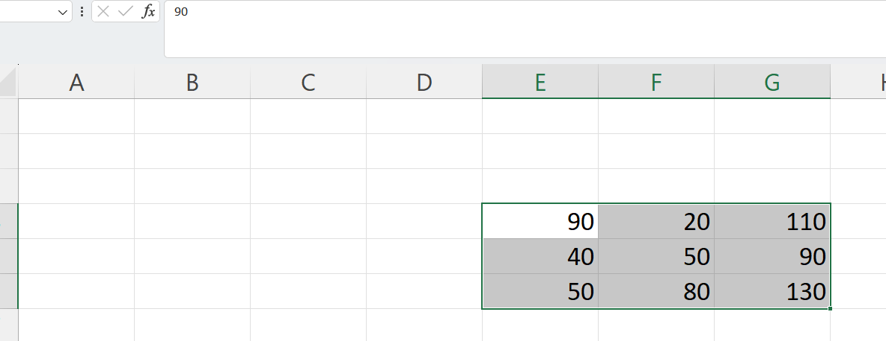
Moving Cells
You can move cells in Excel using two methods: drag and drop or copy and paste.
Drag and Drop
Type or copy some values.
Select the cells in A1 to C3.
Move this selection to E4 to G6 by dragging it. Just click, hold the left mouse button, move to the new spot, and release when you see the move symbol.

Slide 19
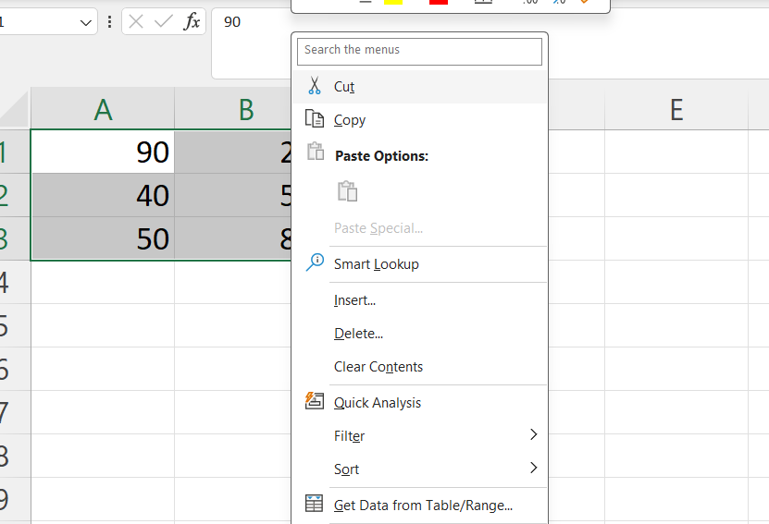
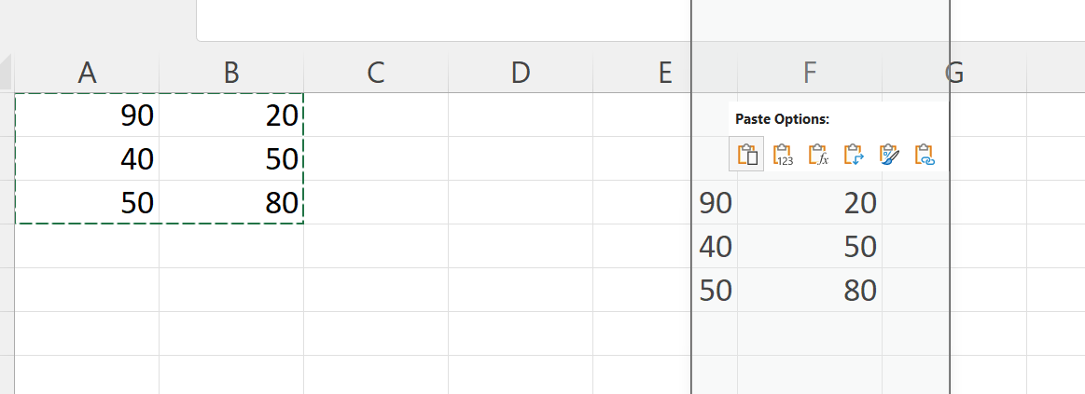
Cut and Paste
Ranges can be moved by cutting and pasting values from one place to another.
You can cut using the hotkey CTRL+X and paste by CTRL+V. This saves you time.

Slide 20
Copy and paste
Copy and paste works in the same way as cut and paste. The difference is that it does not remove the original cells.
You can copy using the hotkey CTRL+C and paste by CTRL+V.
Copying gives the range a dotted green border. This indicates that the range is copied and ready for pasting.
Right click the paste destination cell and left click the paste.
The difference between cutting and copying, is that cutting removes the originals, while copying leaves the originals.

Slide 21
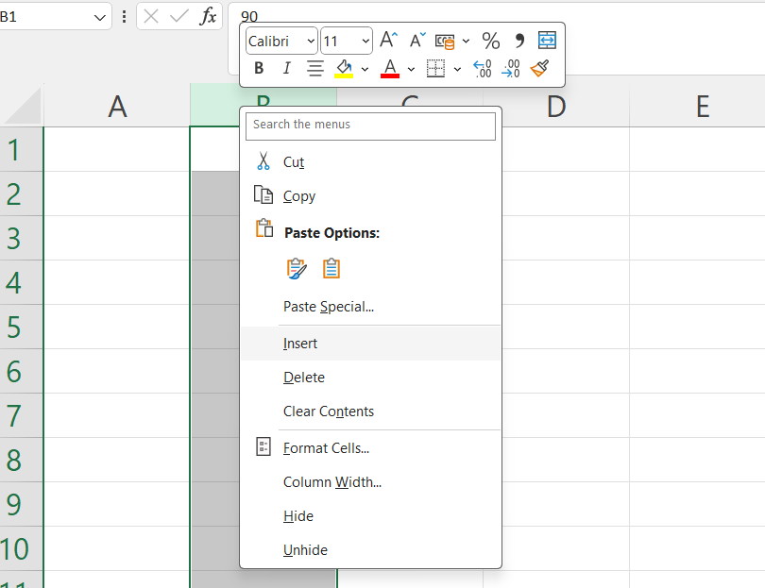
Excel Add Cells
In Excel, you can add or delete columns easily:
Adding Columns:
Right-click on the letter of the column where you want to add a new one.
Select "Insert Columns".
A new column will appear right where you clicked.
Deleting Columns:
Right-click on the letter of the column you want to delete.
Select the option to delete the column.
This way, you can manage your columns with a simple right-click.

Slide 22
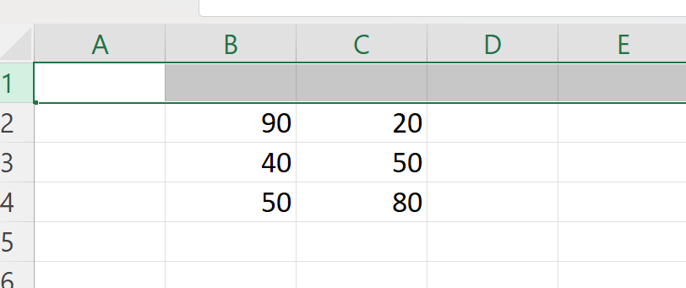
Adding New Rows
Rows can also be added and deleted. You access the menu by right clicking the row number.
New rows are added to the same place you clicked.

Slide 23
Thank you

